Slide 1
MUSIC CLASSIFICATION USING CNN
Presented by:
YOUR NAME

Slide 2
INTRODUCTION
In today's world, where we have an overwhelming amount of music data, organizing and categorizing it efficiently is a challenge. This project focuses on music classification, using advanced Convolutional Neural Networks (CNNs) to understand the complex patterns in audio data. The aim is to create a powerful music classification system that can identify various genres and musical attributes accurately. By leveraging deep learning, we want to go beyond traditional methods, providing a dynamic and adaptable solution that evolves with changing musical preferences. This project is significant as it has the potential to transform how we discover and interact with music, offering a more personalized and nuanced music recommendation experience.

Slide 3
AIM
This project aims to develop an advanced music classification system using Convolutional Neural Networks (CNNs) to accurately identify genres and musical attributes.
The goal is to surpass traditional classification methods and create a dynamic system that adapts to changing music preferences.
The upcoming chapters will explore existing literature, system architecture, and implementation details, with the anticipation that this project will contribute to the field of intelligent music systems.

Slide 4
Module Description for CNN Architecture
1. Convolutional Neural Network (CNN) Module
Overview:
The CNN module defines the architecture for the Convolutional Neural Network, which serves as the core of this image classification model.
Functionality:
Input Layer (Conv2D):
Convolutional layer with 32 filters, each of size (3, 3), and ReLU activation.
Input shape set to (256, 256, 3) to accommodate RGB images.
Pooling Layer (MaxPooling2D):
Max pooling layer with a pool size of (2, 2) to Downsample the spatial dimensions.

Slide 5
Second Convolutional Layer (Conv2D):
Additional convolutional layer with 64 filters and ReLU activation.
Followed by another Max Pooling layer for further down sampling.
Third Convolutional Layer (Conv2D):
Another convolutional layer with 64 filters and ReLU activation.
Prepares the data for the fully connected layers.
Flatten Layer:
Flattens the multi-dimensional data into a one-dimensional array for input into fully connected layers.
Dense Layers (Fully Connected):
Dense layer with 64 neurons and ReLU activation for feature learning.
Output layer with 10 neurons and SoftMax activation for classification into 10 classes.
Model Compilation:
Compile the model using the Adam optimizer with a learning rate of 0.001.
Utilize sparse categorical Crossentropy as the loss function for classification tasks.
Monitor accuracy as the evaluation metric.

Slide 6
2. Usage:
Create an instance of the Sequential model.
Add layers sequentially to define the architecture.
Compile the model to configure its learning process.
This module provides a flexible and scalable CNN architecture for image classification tasks, enabling users to adapt it to various datasets and classification requirements.

Slide 7
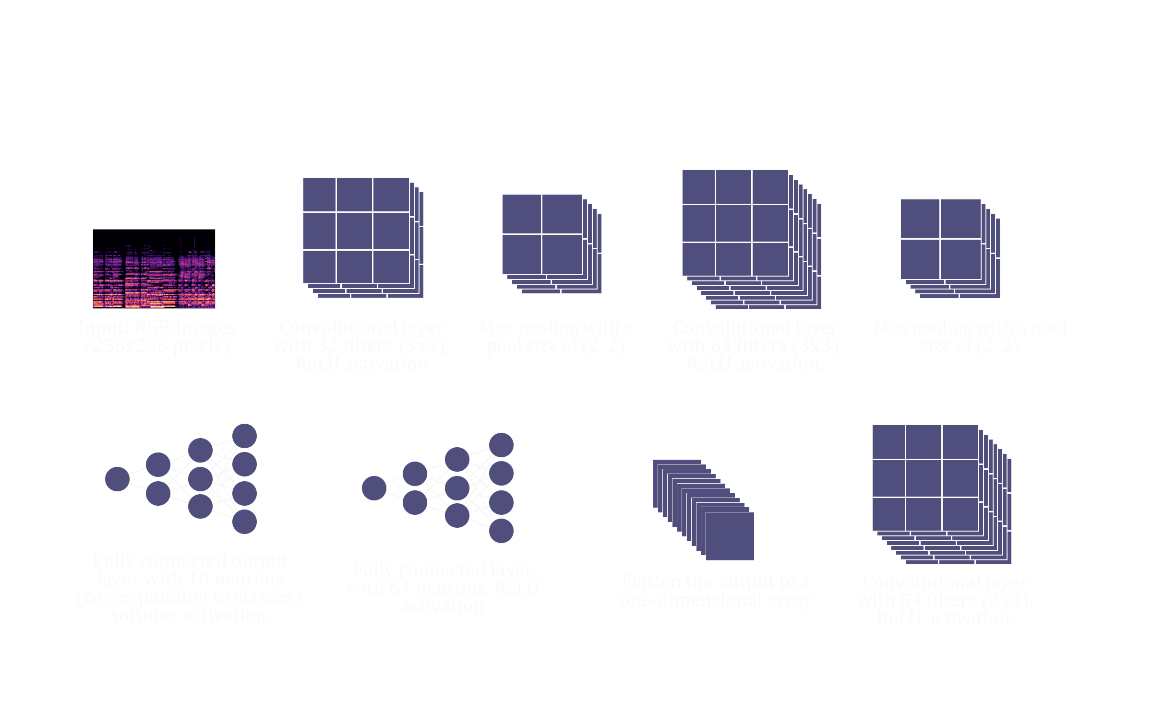
ARCHITECTURAL DIAGRAM

Slide 8

SCREEN SHOTS

Slide 9
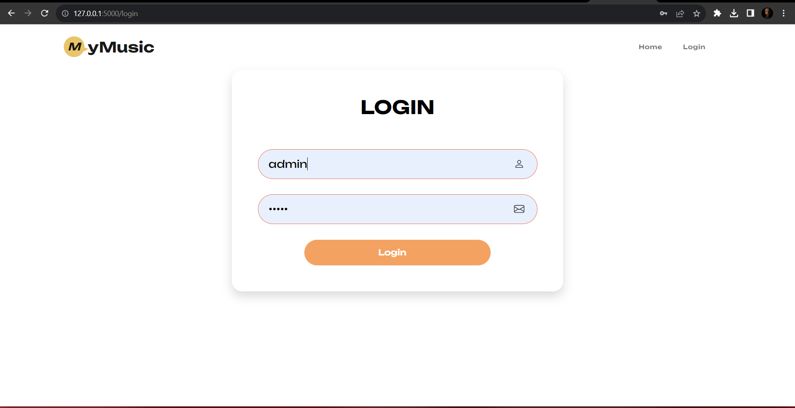

Slide 10


Slide 11
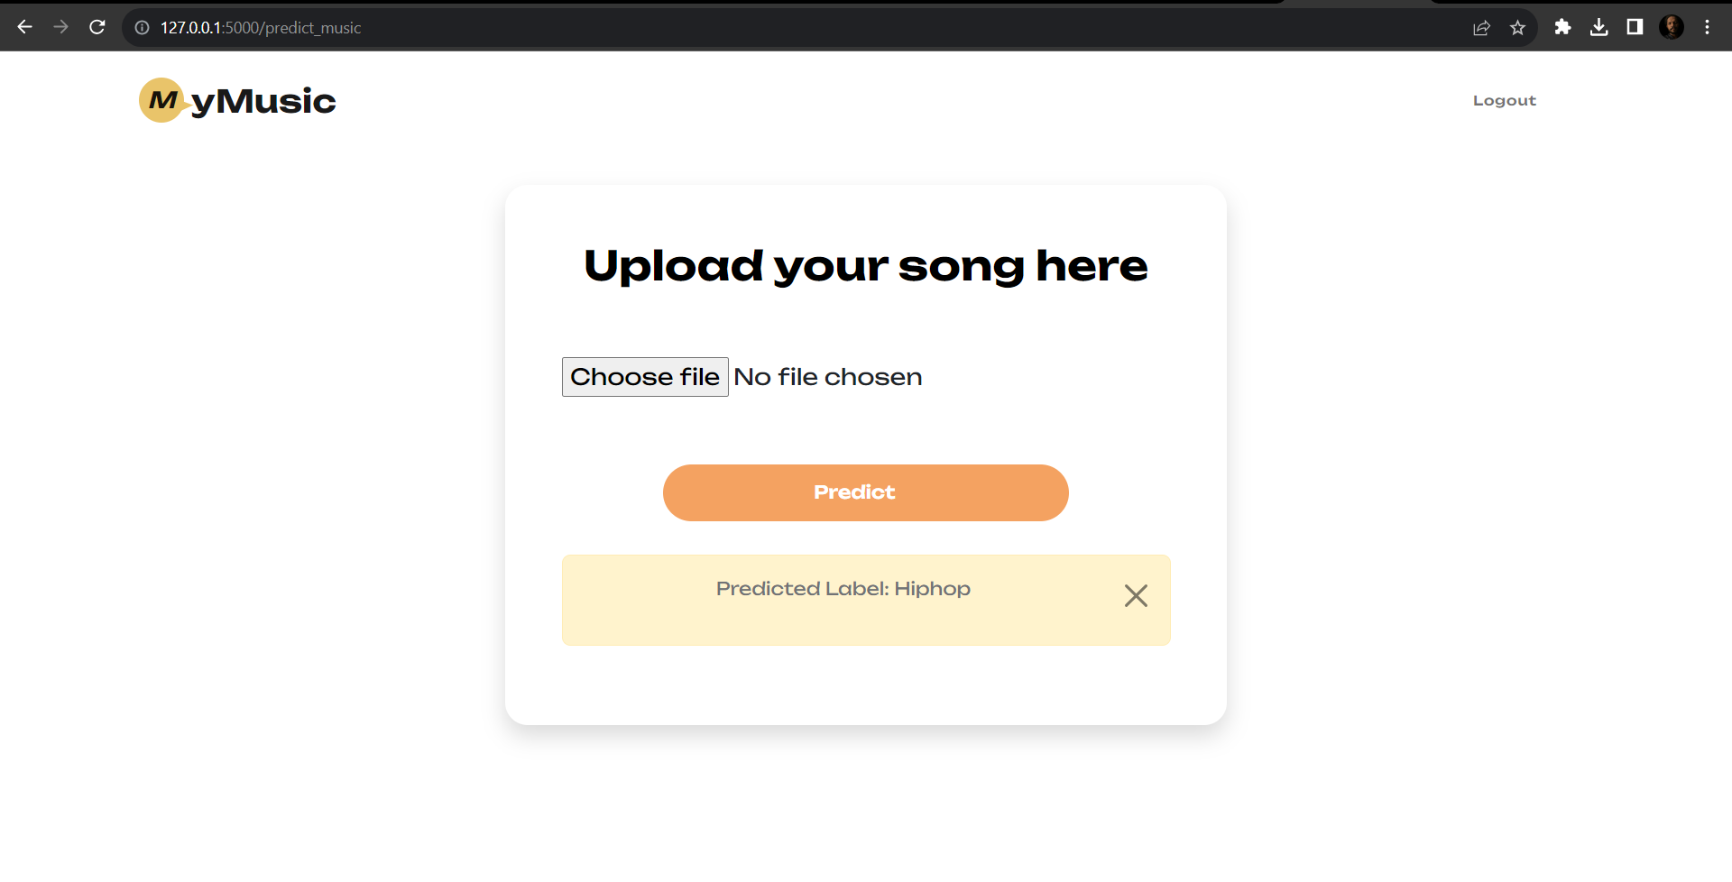

Slide 12
CONCLUSION
In wrapping up my project on music classification using Convolutional Neural Networks (CNNs), I have achieved significant milestones. The system effectively identifies genres in real-time, showcasing the power of deep learning in audio signal processing. The user-friendly interface enhances accessibility, making it a valuable tool for music enthusiasts.
The success of this project underscores the potential of advanced technologies in reshaping how we interact with and appreciate music. By accurately categorizing audio features, I have laid the groundwork for personalized music recommendations and genre exploration.

Slide 13
Looking ahead, there are exciting possibilities for expanding and refining our music classification system: Semantic Analysis: Incorporating semantic analysis to understand lyrical content and provide insights into the emotional context of songs. Continuous Learning: Enabling the system to adapt to emerging music genres and styles through continuous learning and model updates. Enhanced Adaptability: Implementing additional preprocessing techniques to enhance the system's adaptability to varying audio quality and diverse musical styles. By addressing these areas, we can elevate the system's capabilities, providing users with an even more enriching and personalized music exploration experience. This marks the beginning of a journey toward more intelligent and responsive music systems.
FUTURE ENHANCEMENTS

Slide 14
REFERENCES
Mingwen Dong, “Convolutional Neural Network Achieves Human-level Accuracy in Music Genre Classification”, [v1] Tue, 27 Feb 2018
Yu-Huei Cheng, “Automatic Music Genre Classification Based on CRNN”, Volume 29, Issue 1: March 2021
Sugianto Sugianto, “Voting-Based Music Genre Classification Using Melspectogram and Convolutional Neural Network”, 05-06 December 2019
Ceylan, “Automatic Music Genre Classification and Its Relation with Music Education”, v11 n2 p36-45 2021
Alexander Schindler, “Comparing Shallow versus Deep Neural Network Architectures for Automatic Music Genre Classification”

Slide 15
THANK YOU

